Slide 1
Electrochemistry of a Lithium ion battery
The reactants in the electrochemical reactions in a lithium-ion battery are the negative and positive electrodes and the electrolyte providing a conductive medium for lithium ions to move between the electrodes. Electrical energy flows out from or in to the battery when electrons flow through an external circuit during discharge or charge, respectively.
Both electrodes allow lithium ions to move in and out of their structures with a process called insertion (intercalation) or extraction(deintercalation), respectively.
During discharge, the (positive) lithium ions move from the negative electrode (usually graphite = “C6”as below) to the positive electrode (forming a lithium compound) through the electrolyte while the electrons flow through the external circuit in the same direction.
When the cell is charging, the reverse occurs with the lithium ions and electrons moved back into the negative electrode in a net higher energy state.

Slide 2
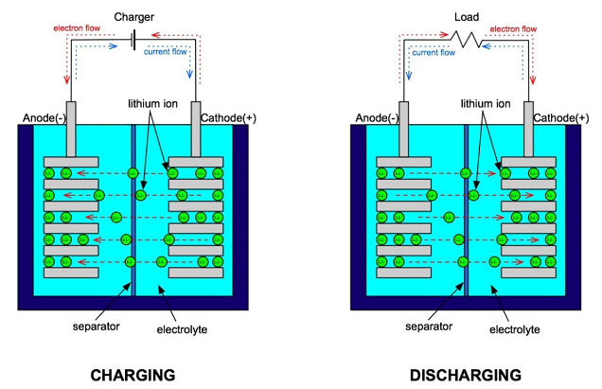

Slide 3
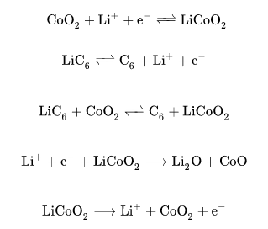
The positive (cathode) electrode half-reaction occurs in the lithium-doped cobalt oxide substrate, while the negative (anode) electrode half-reaction in the graphite.
The overall reaction has its limits. Overdischarge supersaturates lithium cobalt oxide, leading to the production of lithium oxide.
The following equations exemplify the chemistry:

Slide 4
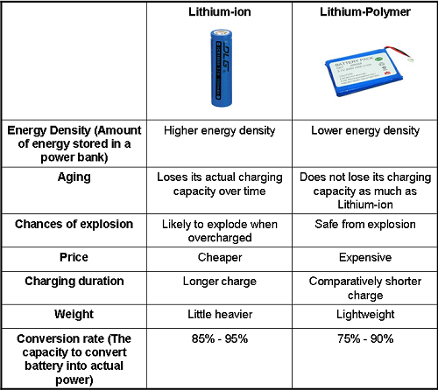
Li-Ion v/s Li-Polymer

